Slide 1
Movie Matchmaker
Angela Angulo, Jessica Whitaker, Stephen Rigney, Elizabeth Lautenslager

Slide 2
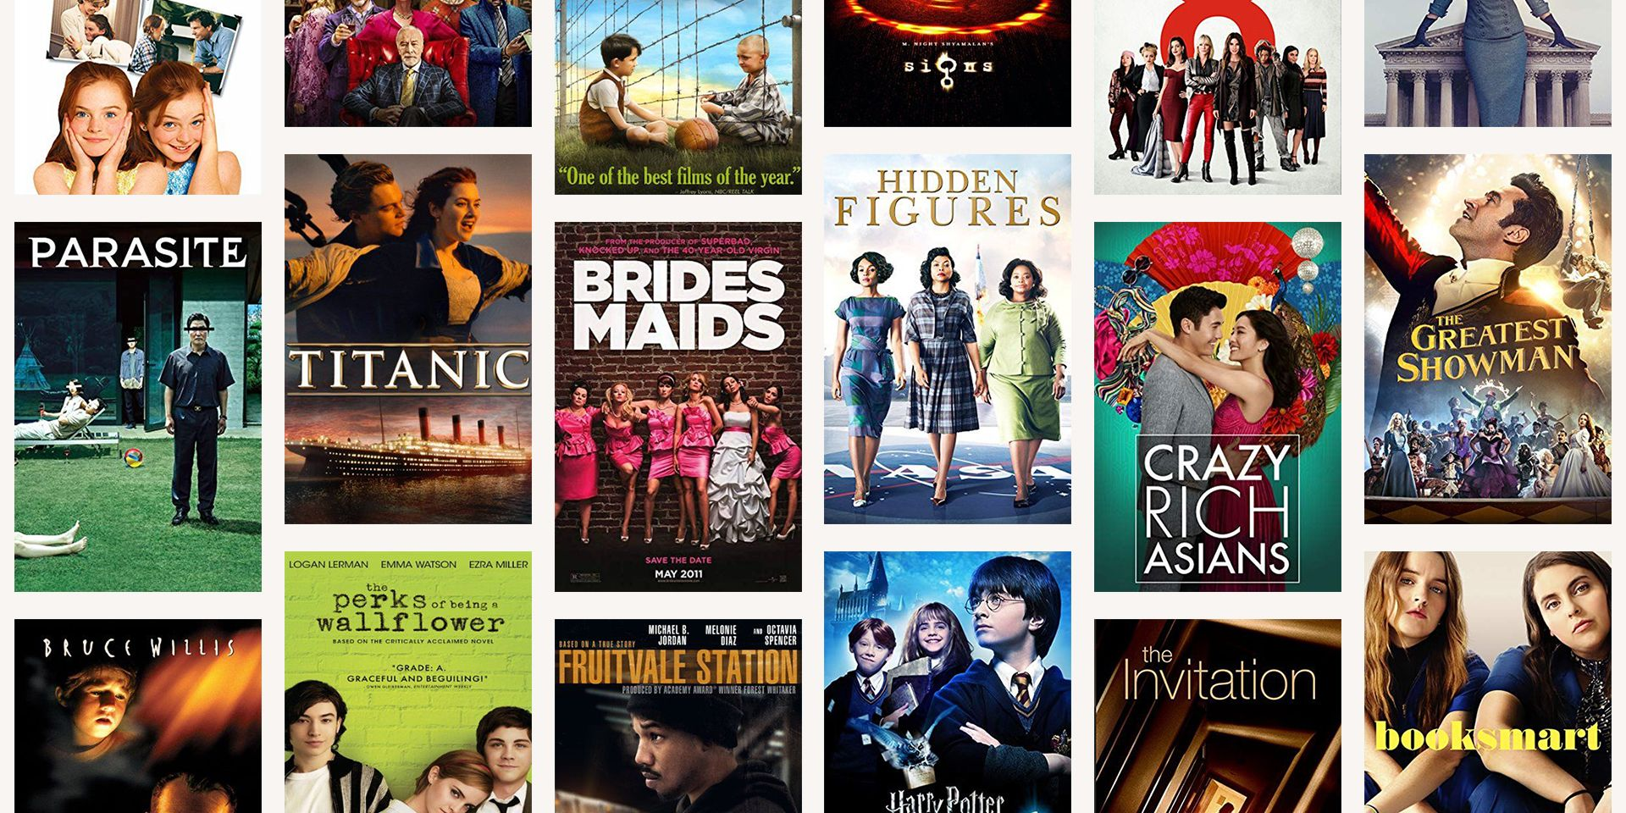
Objective
Create an application that would:
→ take user inputs regarding movies they have seen and enjoyed…
→ provide recommendations based on a machine learning model for other movies to watch next

Slide 3
Data Sources
Analysing Gender Bias in Narrative Tropes (github.com/dhruvilgala/tvtropes)
This was the inspiration for the project and held a lot of the data that we initially used.
Analyzing Gender Bias within Narrative Tropes: (aclanthology.org/2020.nlpcss-1.23/)
Video/Slidedeck from the above GitHub: slideslive.com/38940608/analyzing-gender-bias-within-narrative-tropes
The dataset that we started with was film_imdb_match.csv and this held 2,733,577 data points.
This dataset held much more data than what we actually needed.

Slide 4
Data Cleaning and Preprocessing
We removed tropes not included in at least 16 movies.
We removed columns that included data points not necessary for our desired outcome.
Columns removed include: Example, CleanTitle, tconst, trope_id, and title_id.
Remaining columns include: Trope and Title.
We then removed duplicates from our dataframe sample of 500.
After completing this step, we noticed duplicates in our dataframe, so we then removed trailing and leading spaces from our dataset and reran the function to remove duplicates.
From there we set the Trope column as our index and ran get_dummies to convert our categorical variables into dummy/indicator variables.

Slide 5
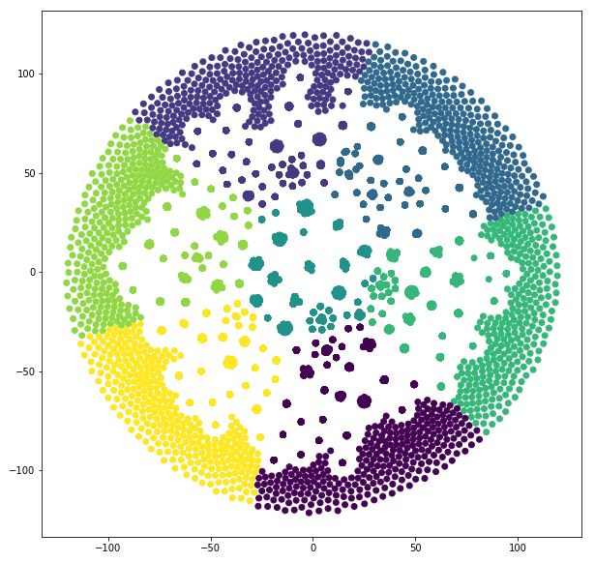
Creating the Model
Data was clustered into 7 groups
Clusters were appended into separate dictionaries
Duplicate title inputs were removed within each dictionary
Cluster lists were combined into a list_of_lists dictionary.
Finally a for loop was created to search for a selected movie within the different list to output a random 10 movies from the same cluster.

Slide 6
Website Walkthrough…

Slide 7
Reflections
What Went Well:
Clear understanding of what we wanted to accomplish.
Finding and cleaning the Data.
Communication among team members.
Finding creative solutions to our problems.
Difficulties Faced:
Deciding which machine-learning method is best for our application.
The size of the data set would take a significant time to download and upload. This required us to be creative with how we stored, shared, and used this data as a group.

Slide 8

Questions?

